Slide 1
Group #2 Milestone #5

Slide 2
Scope
Milestone #1 | Importance of Big Data Security Big Data Security Technologies
Milestone #2 | Big Data Security Risk
Milestone #3 | Big Data Security Use Cases
Milestone #4 | Big Data Security Issues Regulations and Policies
Milestone #5 | Implementation Part 1
Milestone #6 | Implementation Part 2
Milestone #7 | Implementation Part 3

Slide 3
Agenda
Discuss machine specification
User management
System Hardening
Installation of Ubuntu and Hadoop
Conclusion

Slide 4
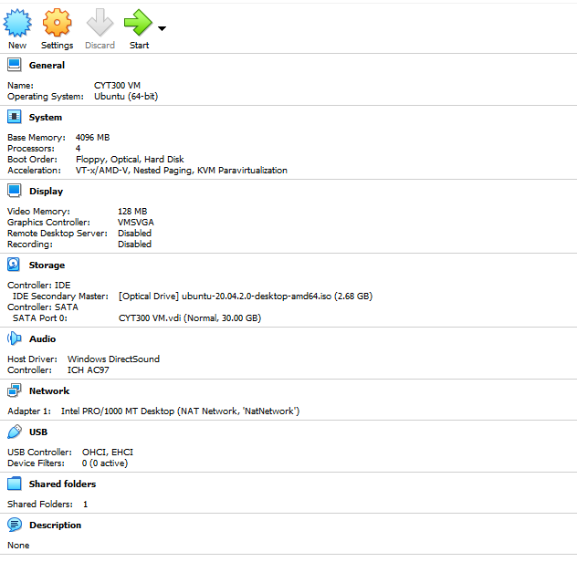
Topic: Machine Specification
Ensure machine spec is up to par
Secure storage by encryption
Disable any peripherals that are unused
https://www.virtualbox.org/wiki/End-user_documentation
Notes:
Notes:
Ensure that the machine specification can run the applications required unhindered and running smoothly throughout.
Encrypting the storage for additional security measures in case of a compromise in the system
Disabling unused peripherals as a good practice
References:
VirtualBox End-user documentation Retrieved July 09, 2021, from https://www.virtualbox.org/wiki/End-user_documentation

Slide 5
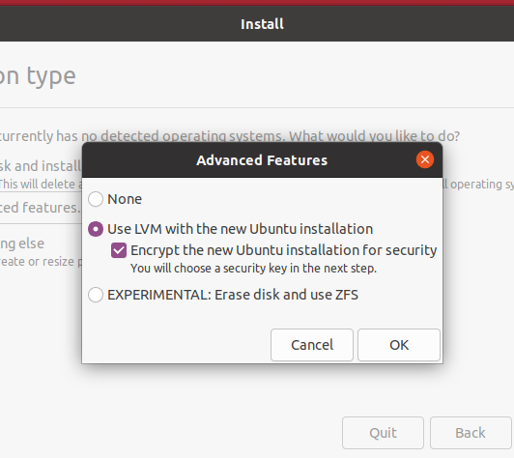
Topic: Disk Encryption
Pros
Enhanced Data Security
Will require password on every boot
Cons
Data is not protected in transit
Slows down the machine significantly
May complicate data recovery
https://help.ubuntu.com/20.10/ubuntu-help/shell-introduction.html.en
Notes:
Notes:
With encryption, the users have another layer of protection that increases the security and privacy of their operating system.
Data protection in transit is observed by using HTTPS/SSL
Data recovery is imperative so that means a company must ensure that the keys are stored in a safe place and is secured but at the same time can be retrieved easily.
References:
6 Advantages & Disadvantages of Full Disk Encryption (FDE). Data Numen. Retrieved July 09, 2021, from https://www.datanumen.com/blogs/6-advantages-disadvantages-full-disk-encryption-fde/
How to Encrypt Your Hard Disk in Ubuntu. . Retrieved July 09, 2021, from https://www.maketecheasier.com/encrypt-hard-disk-in-ubuntu/

Slide 6
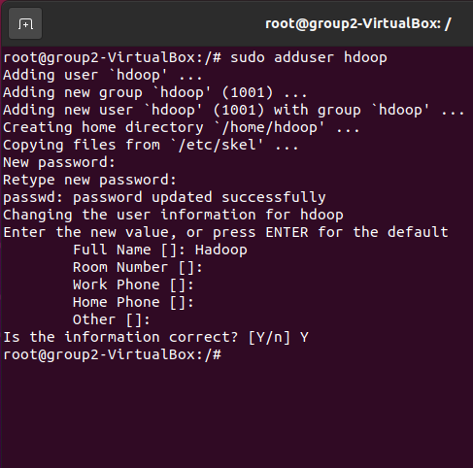
Topic: Managing User Accounts
Disabled the root user
Creating a new user with sudo privileges
Ability to audit user actions
Accountability in place
Minimize errors / command issue
https://help.ubuntu.com/community/UsingTheTerminal
Notes:
Notes:
User management is a critical component to maintain system security.
The misconfiguration of user and privilege management frequently leads to dire situations such as the system being compromised. As a result, it is important that one knows and understand how to protect the system through this simple and effective account management.
References:
User Management. Retrieved July 09, 2021, from https://ubuntu.com/server/docs/security-users/

Slide 7
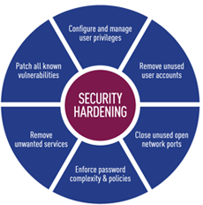
Topic: Systems Hardening
Reduce Surface Attacks
Network encryption
Encrypted data at rest
Operating system hardened
Removing unnecessary accounts and privileges
http://www.tripwire.com/data-security/security-hardening/
Notes:
Notes:
Reduce the surface attack by identifying and mitigating some concerns such as:
OS Default passwords
Passwords and credentials that may have been stored in plain text
Unpatched software and other vulnerabilities
Unencrypted network traffic, unencrypted disks
Operating system hardening: Ensure that the OS is up to date, patches are automatically updated, no unnecessary drives installed
References:
Beyond Trust, Systems Hardening. Retrieved July 09, 2021, from https://www.beyondtrust.com/resources/glossary/systems-hardening

Slide 8
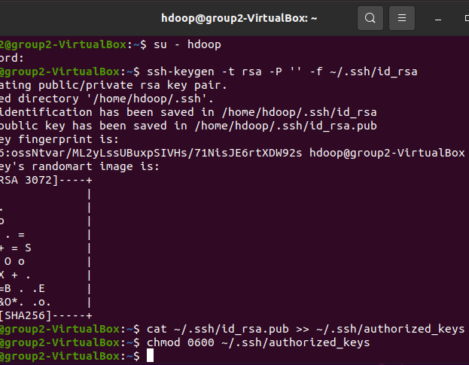
Topic: SSH key based authentication
Makes the system more secure
Not susceptible to brute force attacks
Keys cannot be guessed
https://help.ubuntu.com/community/SSH/OpenSSH/Keys
Notes:
Notes:
By ensuring we use SSH key based authentication and removing password-based authentication, we harden the system and mitigate brute force attacks.
The way SSH key based authentication works is with the Private and Public keys. The private keys are stored in the user’s system and the public is stored in the authorized_keys of the remote machine – and the authentication is done whenever the private and the public keys match up.
References:
Thorn Technologies (2017), Passwords vs. SSH keys – what’s better for authentication?. Retrieved July 09, 2021, from https://www.thorntech.com/passwords-vs-ssh/

Slide 9
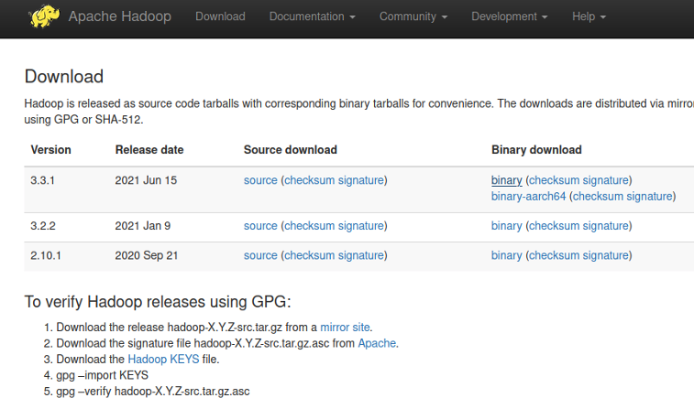
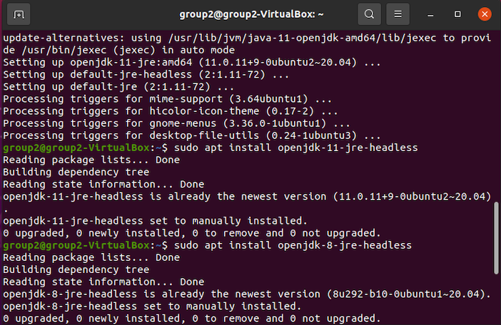
Topic: Installing Hadoop and the prerequisites
Java 8 Installation
Hadoop installation
Optional installation of openssh-server
Verifying the Hadoop version installed
https://hadoop.apache.org/releases.html
Notes:
Notes:
Hadoop requires Java as a prerequisite so, we install Java.
After that, Hadoop installation is trivial, the users would only need to download the binary files and install in the appropriate folder such as /opt/
Installation of the openssh-server is required if it hasn’t been installed yet- this is a prerequisite to enable HDFS to connect to the localhost:9000 in the context of this exercise.
References:
Apache Hadoop. Retrieved July 09, 2021, from http://hadoop.apache.org/releases.html
Java 8. Retrieved July 09, 2021, from https://docs.oracle.com/javase/8/index.html

Slide 10
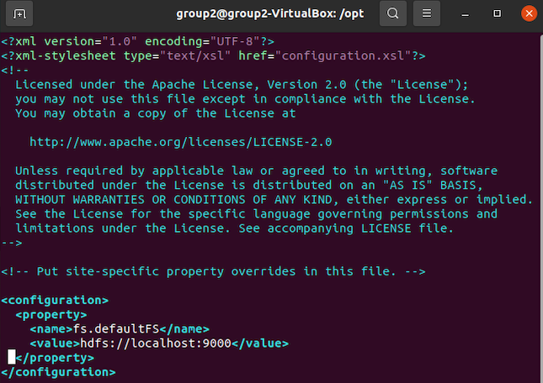
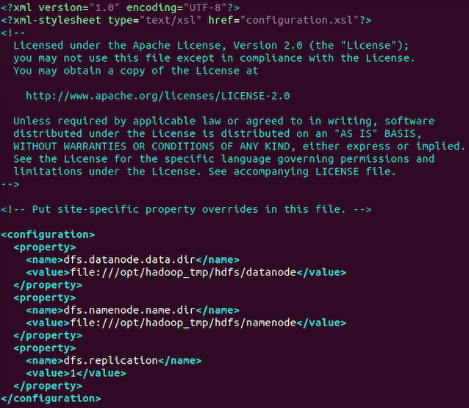
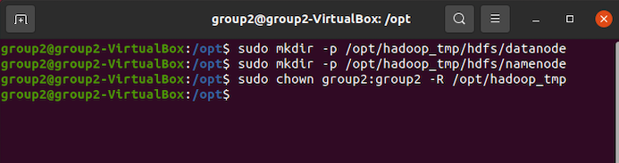
Topic: Setting up configuration and permissions
Set up core-site, hdfs-site
Enable permissions to temp folders to hold data
Set up replication node value, currently set as 1
https://help.ubuntu.com/community/UsingTheTerminal
Notes:
Notes:
One of the requirements to have Hadoop up and running is to ensure that the services have been configured correctly based on its requirements.
There is an array of configuration for the core-site.xml and hdfs-site.xml but for simplicity, this presentation only shows the temp folder structure as well the replication number.
To know more about configuration parameters, we can refer to the Hadoop documentation under the configuration tab.
References:
Apache Hadoop 3.3.1, Retrieved July 09, 2021 from https://hadoop.apache.org/docs/r3.3.1/
Core Default XML Config (2021). Retrieved July 09, 2021, from https://hadoop.apache.org/docs/r3.3.1/hadoop-project-dist/hadoop-common/core-default.xml

Slide 11
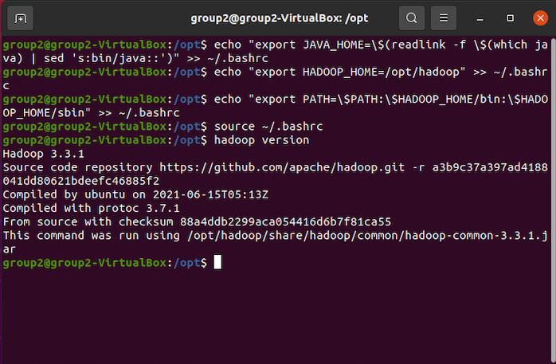
Topic: Setting up environment variables
Shows the list of configuration on a high level
Ensures that we follow the DRY (Don’t repeat yourself)
Reduces the chances of string input error
Follows best practice
https://help.ubuntu.com/community/UsingTheTerminal
Notes:
Notes:
Environment variables are imperative because of the way it reduces the repetition on our source code and avoid hard coding, this enables for faster deployments in different stages of the lifecycle of an application, in this case Hadoop.
It follows the don’t repeat yourself principle in software development, wherein it aims to reduce the repetition of software patterns, in this case configuration files.
References:
CodeBurst (2018), What are Environment Variables? Retrieved July 09, 2021, from https://codeburst.io/what-are-environment-variables-the-use-case-43fdb2c7860
Hunt, Andrew; Thomas, David (1999). Retrieved July 09, 2021, From https://archive.org/details/isbn_9780201616224/page/320

Slide 12
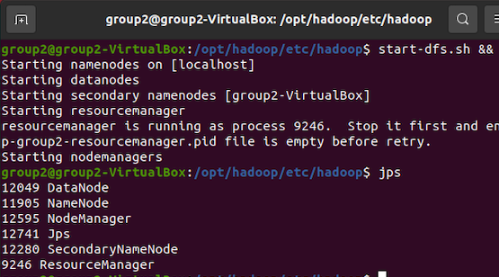
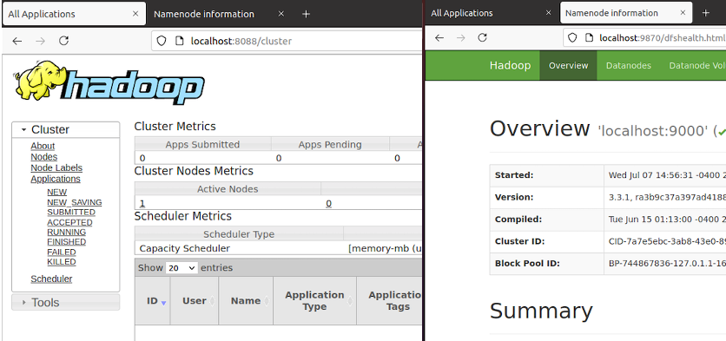
Topic: Hadoop monitoring, and services up and runing
Ensure all services are up and running
Check for cluster metrics
Check for the application overview
https://help.ubuntu.com/community/UsingTheTerminal
Notes:
Notes:
To have the Hadoop running, at a minimum we need to see the NameNode and DataNode when we run the jps command. Once this node is running, we will be able to check the cluster metrics and the cluster overview on the browser, on ports 8088 and port 9870 respectively.
The Hadoop cluster metrics reveals the status of its internal components, and it is used for monitoring, performance tuning and debugging. Additionally, this also shows us to number of live nodes that are currently running along with other useful metrics.
On the other hand, the overview is the is the master node and it is responsible of controlling and live nodes or slave nodes.
References:
CodeBurst (2018), What are Environment Variables? Retrieved July 09, 2021, from https://codeburst.io/what-are-environment-variables-the-use-case-43fdb2c7860

Slide 13


Conclusion
There are multiple concerns in terms of security, scaling and deployments when running Hadoop. Implementation part 1 demonstrates how one should tackle the installation of Ubuntu, ensuring that the storage is encrypted, users are managed properly, and are only given permission to the resources the user needs.
Additionally, we also observe system hardening through several practical application such as reducing surface attacks, ensure that SSH key based authentication is enabled.
Finally, we finish up with the installation and verification that the Hadoop cluster is up and running.

